Slide 1

LinkedIn Job Trend Analysis
Skill Demand Across Roles & Locations

Slide 2
Title: What We Analyzed
Data Source: 10,000+ LinkedIn job postings
Focus Areas:
Top demanded skills
Geographic trends
Role-specific requirements
Tools Used: Python, Pandas, BeautifulSoup

Slide 3
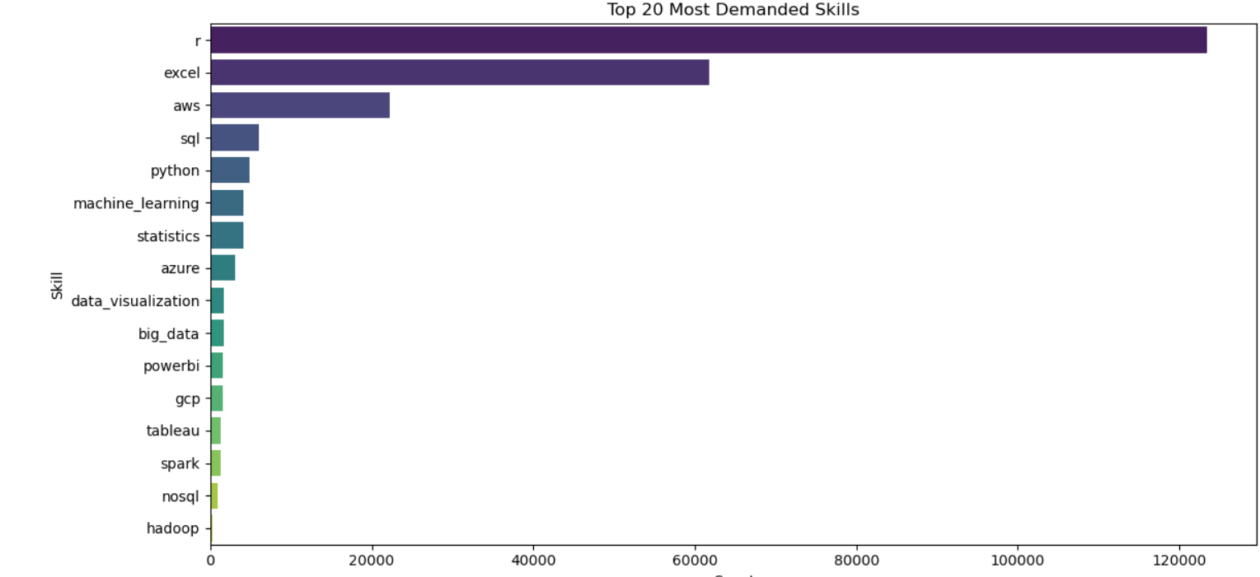
Title: The Must-Have Skills in 2024

Slide 4
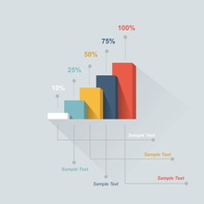
*"Python (32%) and SQL (28%) are most demanded. Cloud platforms (AWS/Azure) show 22% growth. Emerging skills include PySpark and TensorFlow for advanced roles."*

Slide 5

Title: Where Skills Are Needed ( Location Matters)
Tech hubs (SF) want coding/AI skills; business centers (NY/London) prioritize analytics tools."

Slide 6
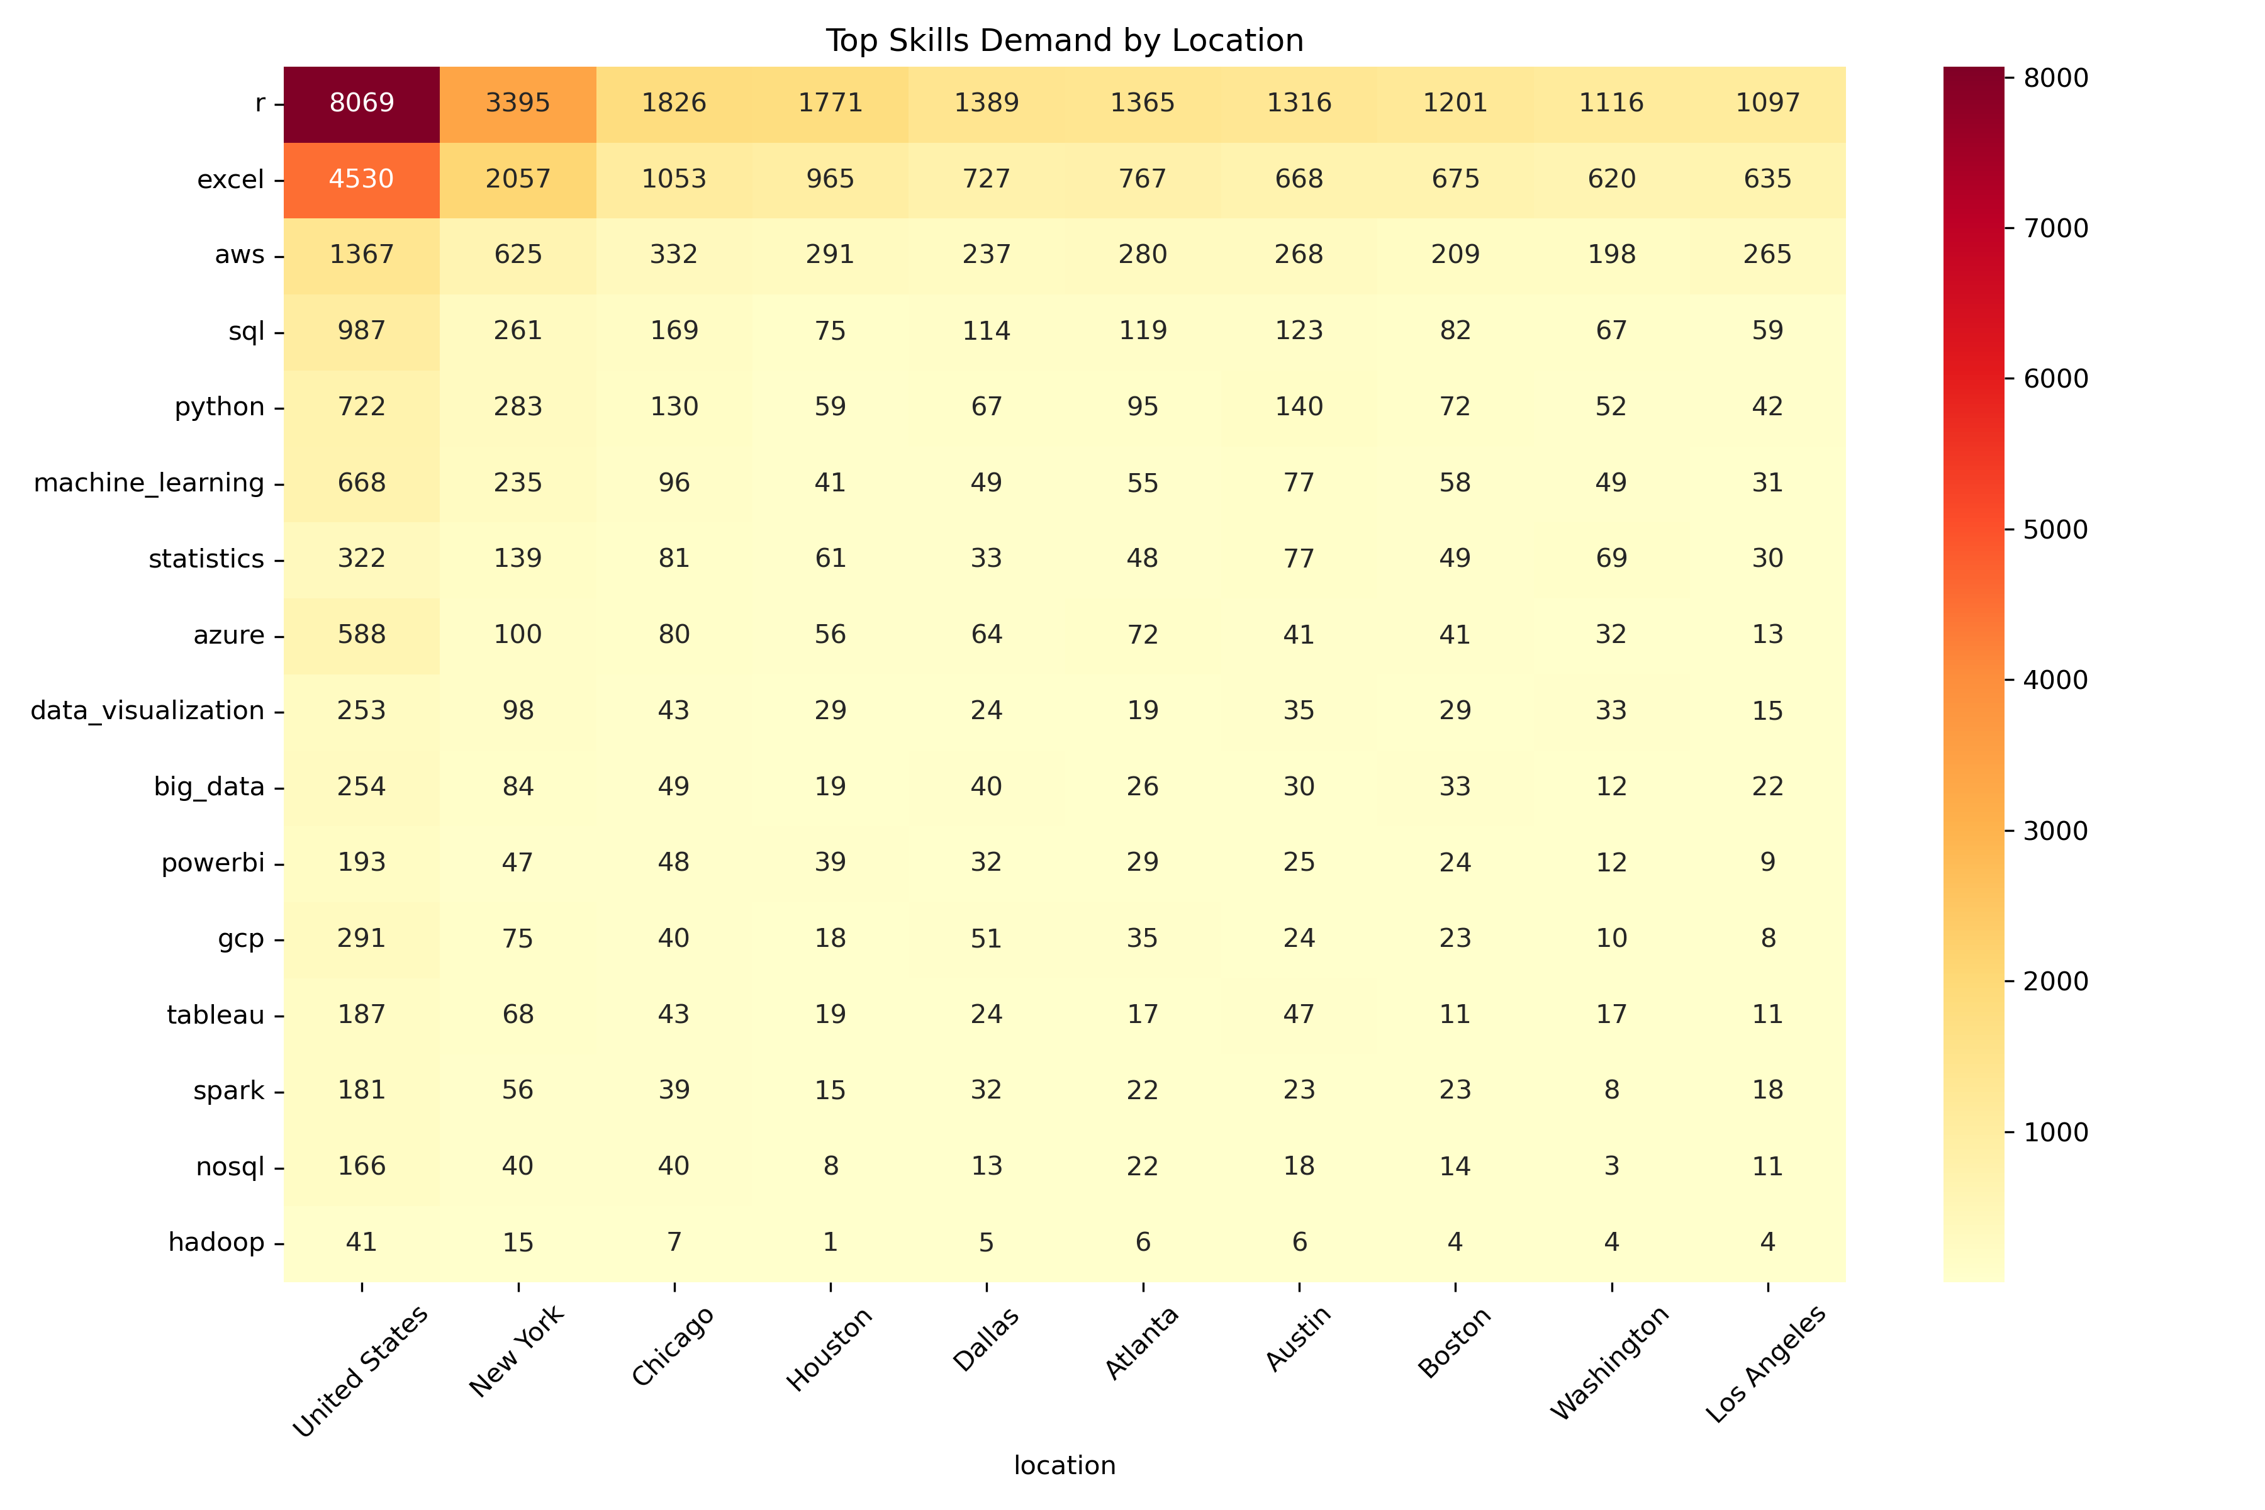

Slide 7

Title : Skills by Job Role(What Employers Want for Specific Role)
Role icons :
Scientists/Analyst/Engineer)+
skill tags
Content:
Data Scientists:
Must have: Python, ML
Nice-to-have: Spark
Business Analysts:
Must have: Excel, SQL
Nice-to-have: Basic Python

Slide 8
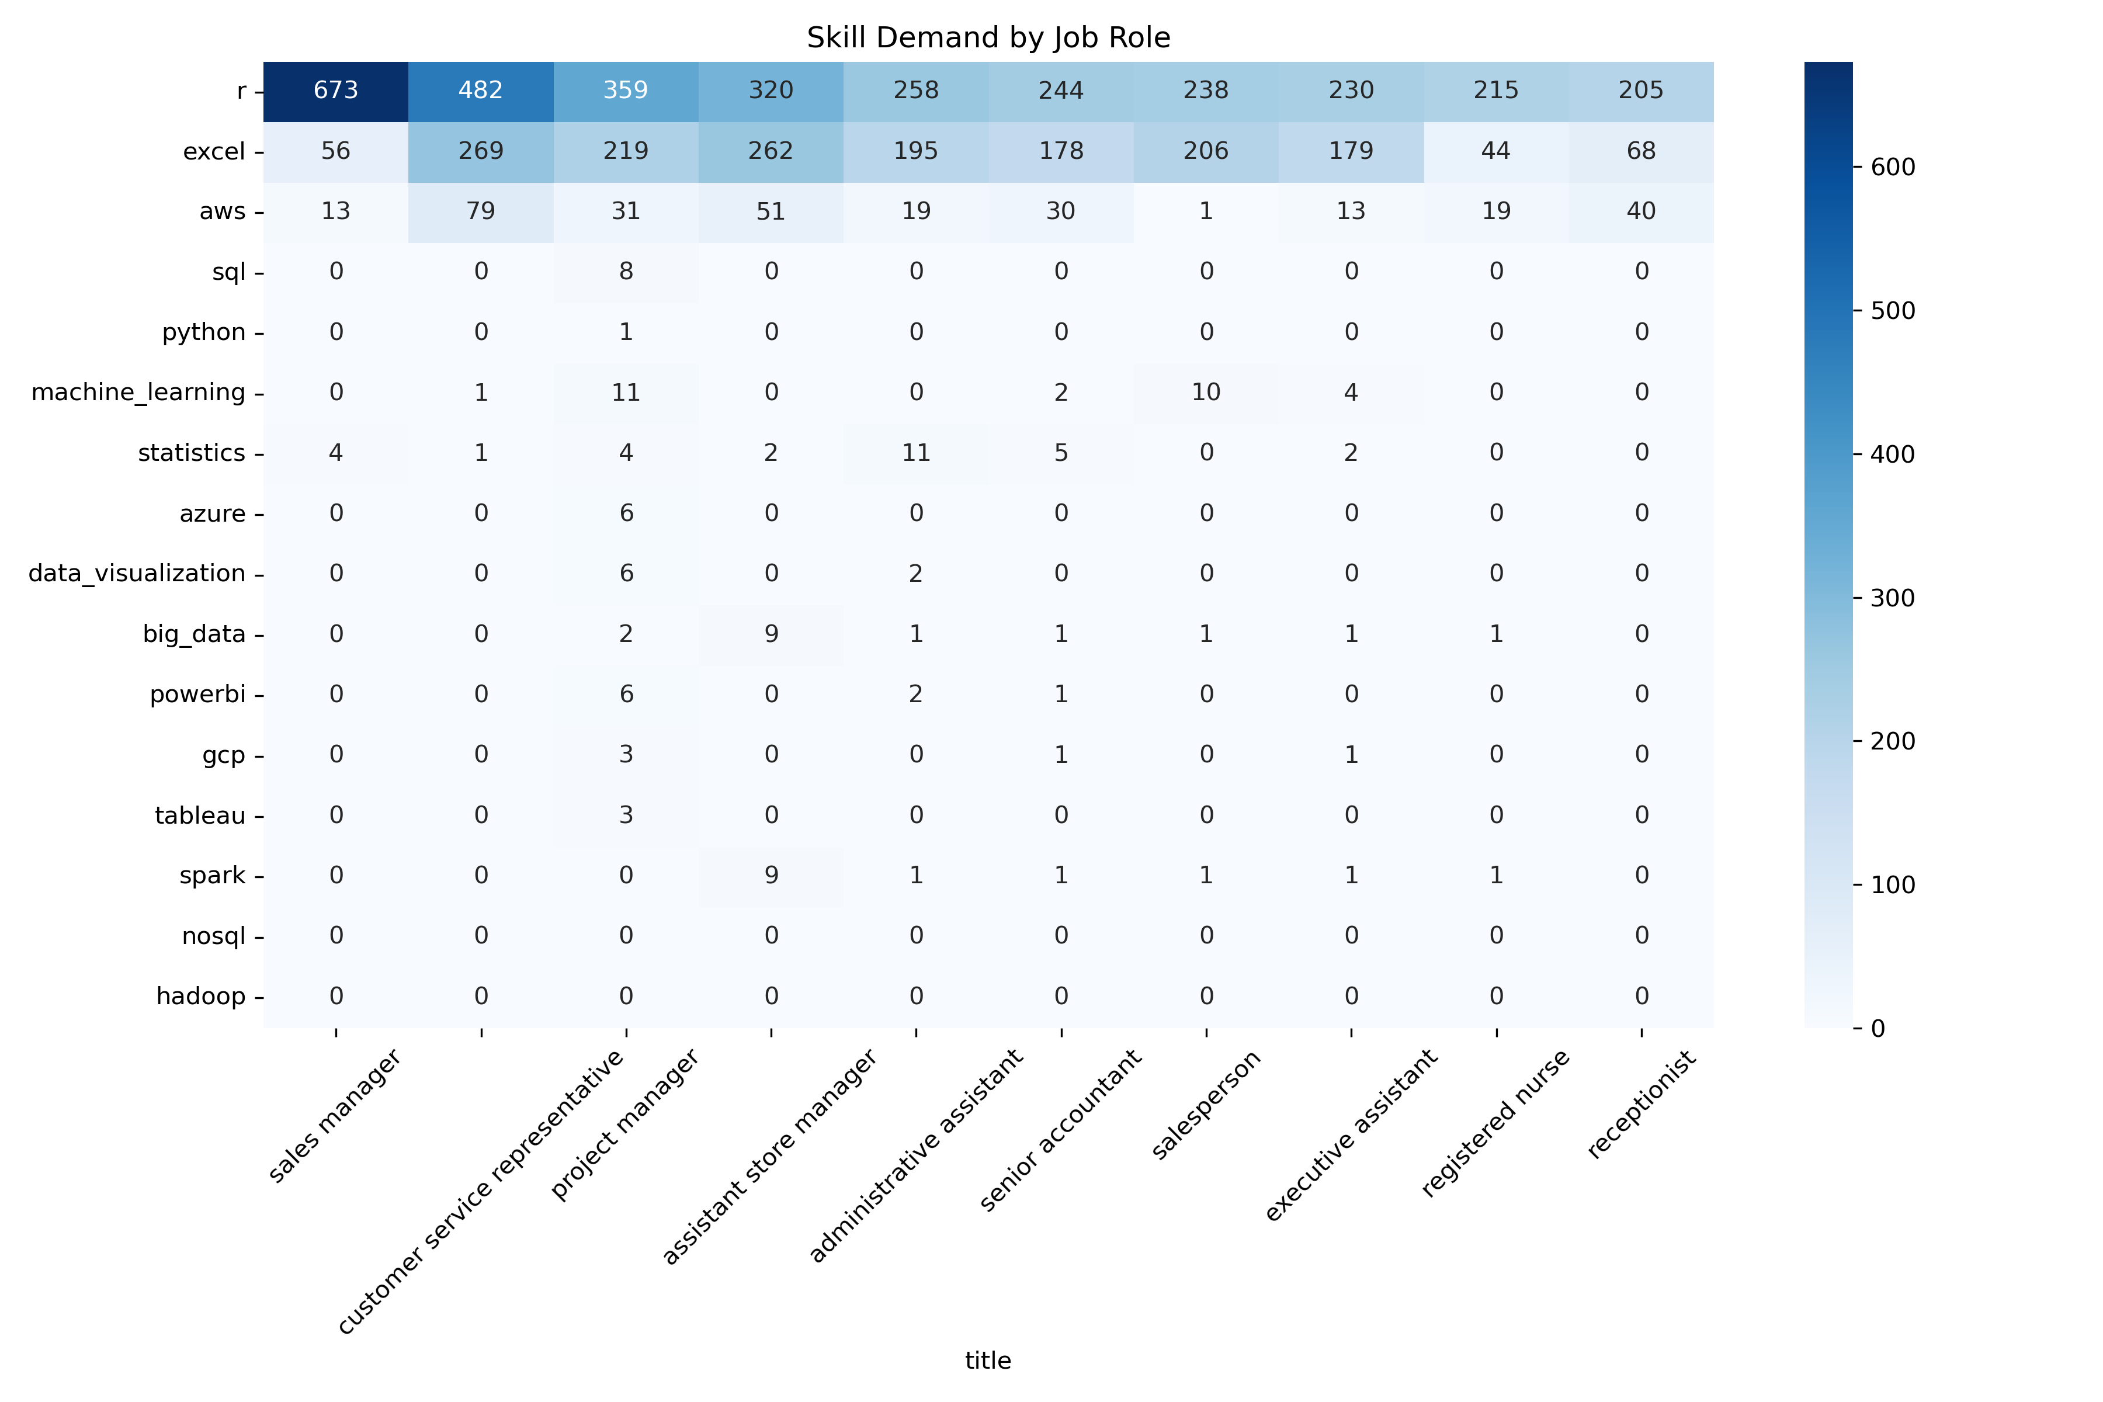

Slide 9

Conclusion
Python/SQL are non-negotiable
Location significantly impacts
requirements
Cloud skills = fastest growing
(+35% YoY)

Slide 10
Thankyou

